Slide 1
C&I Management Review
October 17, 2014

Slide 2
Agenda
Key Topics
Management Review Refresh
AMR Executive Summary
Operating GMA in Multiple BUs
External UL CBTLs
Consistent ISO 17065 Accreditor Interpretations
FUS Sample Testing
CARs – significant nonconformances
Component Acceptance & Substitution Program (CASP)
Management Reviews
UL Global Quality Manual
Meeting Expectations
Key Topics
AMR Scorecard
Conclusion
Other Business
Purpose: provide oversight and assess the effectiveness of the C&I quality management system.

Slide 3
Management Review Refresh New Structure
CPC
BU
Specific
Strategic Focus UL
Strategic Focus BU
Inter BU
New Level
Program / Location / Function
Technical Focus
Roll Up

Slide 4
C&I AMR – executive summary
October 17, 2014
4

Slide 5
AMR – executive summary
Operating GMA in Multiple BUs
Efficiency of the UL CB Scheme program operations depends on UL operating as “one corporate family using the same quality system” – using a single quality system across C&I, Consumer, and LHS with the same UL CB Scheme policy and procedures
This allows work to be easily shared or subcontract between UL facilities which would otherwise would not be permitted or become more difficult and costly
Failure to maintain consistency would impair UL’s ability to easily share work between NCBs:
require subcontracting agreements between labs
increase external auditing requirements
additional scope management
Recommendations / Action Items:
Maintaining CPO and NCBs involvement with pilot projects and their future roll outs to help ensure that the CB Scheme considers UL as 1 organization – 1 set of procedures with consistent external communications.

Slide 6
AMR – executive summary
External UL CBTLs
UL carried out an initial qualification of reviewers at 40+ external CBTLs; however, there is no comprehensive UL technical review of the CB Scheme work performed by these labs
Each NCB is required to manage CBTLs based on performance and business needs, including monitoring of results (e.g., # of CBTRs issued, Proficiency Test Program (PTP) outcomes, audit results) – to support continued relationships
Coordination of oversight is needed as some NCBs cross between BUs (C&I, L&H, Consumer)
Recommendations / Action Items:
NCB Forum (CPO) developing proposal and collaborating deployment of a structured management process including NCB manager roles / responsibilities.

Slide 7
AMR – executive summary
Consistent ISO 17065 Accreditor Interpretations
Working with different accreditors (about 20 CO) has resulted in varying interpretations of the ISO 17065 requirements
It is not practical to develop and maintain accreditor-specific policies and procedures
This will be a greater concern for stand-alone / local accreditors & accreditations (e.g., ANATEL, DANAK, DENAN, INMETRO, JAB, JAS-ANZ, METI, MHLW, OAA, SAC, UKAS, ZLS (GS), …etc.)
Recommendations / Action Items:
Engaging Accreditation Services and CPO during ISO 17065 transition audits for accreditation through the end of 2015.

Slide 8
AMR – executive summary
FUS Sample Testing
Process improvement initiatives have been completed resulting in a 81.2% (54,426) FUS Tag completion rate within 90 days
test sample routing
assuring test program correctness
monthly performance reporting
letter report quality and TAT
documented process for WTDP at client/TPTDP labs
Multiple repeat external and internal CARs have occurred as a result of ineffective corrective actions.
failure to disposition noncompliant products in a timely manner
excessive turn around time
lack of records
Recommendations / Action Items:
Quality Engineering working with Process Engineering to develop industry-specific online KPIs (e.g., WoH by queue, TAT, Throughput) to effectively manage the process.

Slide 9
AMR – executive summary
CARs – significant nonconformances
Missing / insufficient / incorrect communication of scope of certification (i.e., standard, revision and edition)
Recorded data does not sufficiently support certification of the product
incorrect testing parameters applied
missing data
test results inadequate to substantiate certification
insufficient recording of Witness Testing information (missing names, test locations, and test facility confirmation)
general data recording errors
Recommendations / Action Items:
Quality Engineering working as Owner’s Assistant on critical repeat CARs
Addressing nonconformances by engaging Quality Team in Business Transformation
Aria – FLEX Pilots (Quality feedback from technical audits and project reviews)
Data Centric Laboratory processes (LIMs Labware / Aurora)

Slide 10
AMR – executive summary
Component Acceptance and Substitution Program (CASP)
The acceptance of these components is described in, and governed by, the various schemes operated by UL LLC
Discussions with ANSI have been positive – need to maintain
UL Mark (Listing, Classification, & Recognition):
UL and c-UL Water Systems Certification Program
Food Equipment Sanitation
Potential ISO 17065 risks based on accreditors acceptance of the approach taken for component acceptance
Recommendations / Action Items:
CPO Accreditation Services working with Accreditors to manage their interpretations through completion of the ISO 17065 transition.

Slide 11
AMR – executive summary
Management Reviews
Robustness of management reviews varies across the organization and need to address new requirements from ISO 17065
participation
inputs
outputs
impartiality
Recommendations / Action Items:
Quality Engineering raising the bar on management review effectiveness assessments.

Slide 12
AMR – executive summary
UL Global Quality Manual 00-QA-P0001
Quality manual revision in-process to clarify ISO 17025 laboratory accreditation requirement for conducting specific types of work
not required by all client project requests
reduces cost and turn around time
remains in effect per program/scheme or accreditation requirements
Recommendations / Action Items:
Review and approval of Quality Manual revisions when submitted for release.

Slide 13
AMR – executive summary
Questions?
Any additional recommendations or action Items?

Slide 14
C&I AMR – Scorecard
October, 2014
14

Slide 15
QMS Category Items / Factors
INFRASTRUCTURE
Document Control (records management)
Program Knowledge / Requirements
ASSESSMENT
Internal / External Audits
Corrective Action Requests (Car System)
Preventative and Corrective Action Analysis
Customer Satisfaction
Complaints and Appeals
Inter-Laboratory Comparisons / Proficiency Tests
MANAGEMENT OVERSIGHT
Management Reviews (Scheme, Lab, Function)
Impartiality Management
Follow-Up On Previous Management Reviews
Changes That Could Effect The Management System
RESOURCES
Changes in Volume and Type of Work
Resource Competency

Slide 16
AMR Scorecard – definitions
Intent / Approach:
Methods used to address business requirements and market needs.
Implementation / Deployment:
Extent to which an "Intent / Approach" is applied – evaluated on the basis of the breadth and depth of application of the approach.
Effectiveness / Results:
How well an implemented approach achieves its purpose. "Results" refers to outputs and outcomes achieved.
Notes:
Intent / Approach: Methods used to address business requirements and market needs.
Appropriate plans, procedures, and systems including effectiveness of their use
Implementation / Deployment: Extent to which an "Intent / Approach" is applied – evaluated on the basis of the breadth and depth of application of the approach.
Evidence that the plans, procedures, and systems have been implemented
Effectiveness / Results: How well an implemented approach achieves its purpose. "Results" refers to outputs and outcomes achieved.
Results are assessed based on current performance; performance relative to appropriate comparisons; the rate, breadth, and importance of performance improvements; and the relationship of results measures to key organizational performance requirements.
Determining effectiveness requires (1) the evaluation of how well the approach is aligned with the organization’s needs and how well the approach is deployed or (2) the evaluation of the outcome of the measure used.

Slide 17
AMR Scorecard – criteria guide
Level
1: Initial, Ad-hoc
2: Repeatable, Rudimentary
3: Defined, Organized, and Repeatable
4: Quantitatively Managed and Sustainable
5: Optimizing
Notes:
Criteria Level 1: Initial, Ad-hoc • No systematic approach is evident; information is anecdotal. • Little or no deployment of an approach is evident. • An improvement orientation is not evident; improvement is achieved through reacting to problems. Level 2: Repeatable, Rudimentary • An effective, systematic approach, responsive to the basic requirements of the process, is evident. • The approach is deployed, although some areas or work units are in early stages of deployment • The approach is in the early stages of alignment with basic organizational needs Level 3: Defined, Organized, and Repeatable • An effective, systematic approach, responsive to overall requirements of the process, is evident. • The approach is fully deployed with minimal weaknesses or gaps in any areas or work units. • A fact-based, evaluation process is in place for measuring the efficiency and effectiveness of the process. Performance objectives with targets are established. • The approach is aligned with the organizational and customer needs. Level 4: Quantitatively Managed and Sustainable • An effective, systematic approach, fully responsive to the requirements of the process is evident. • The approach is fully deployed without weaknesses or gaps in any areas or work units. • A fact-based, systematic evaluation and improvement process is in place for improving the efficiency and effectiveness of the process. Performance against established objectives and targets is monitored to identify opportunities for improvement. • The approach is fully aligned with the organizational and customer needs. Level 5: Optimizing • An effective, systematic approach, fully responsive to the requirements of the process is evident. • The approach is fully deployed without weaknesses or gaps in any areas or work units. • A fact-based, systematic evaluation and improvement process with organizational learning are integrated into the process for improving efficiency and effectiveness. Cycles of improvement have been completed resulting in sustained trends of improved performance for the critical process characteristics that is supported by data. • The approach is well integrated with the organizational and customer needs.

Slide 18
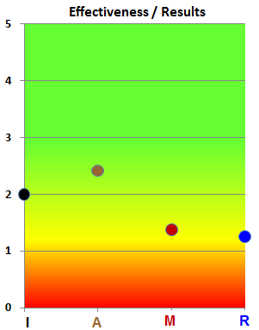
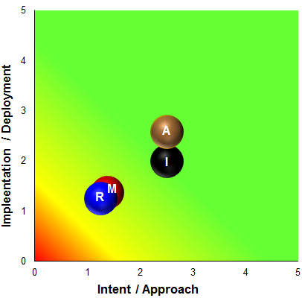
Intent / Implementation / Effectiveness

Slide 19
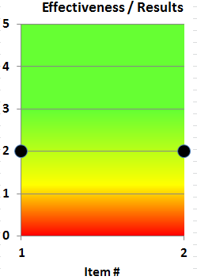
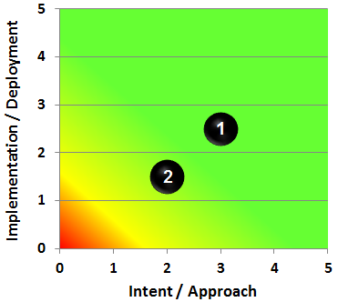
Infrastructure

Slide 20
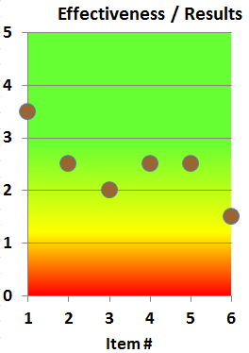
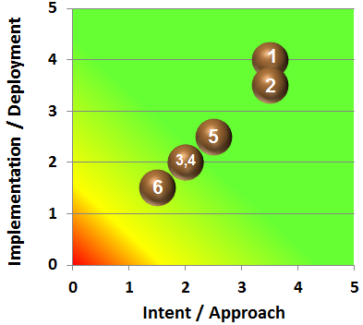
Assessment

Slide 21
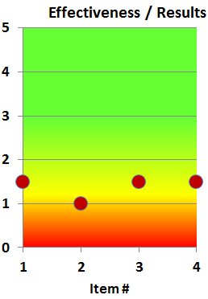
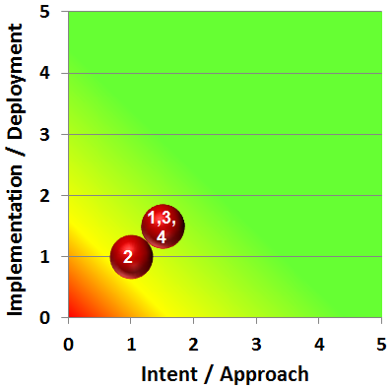
Management Oversight

Slide 22
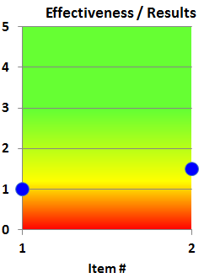
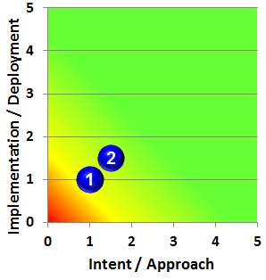
Resources

Slide 23
Conclusions Suitability and Effectiveness of Quality System
Feedback
Is the quality system considered to be suitable and effective?
Purpose: provide oversight and assess the effectiveness of the C&I quality management system.

Slide 24
Other Business Quality – future direction
The Global Quality Organization provides enterprise-wide and local level support for Business Units and UL's Quality Management System to drive performance improvement of quality services that conform to established standards and accreditation requirements:
Documentation Control
Internal Quality Audits (process and technical)
Corrective Action Requests
Local Site Support
Accreditation and audit support
Process development and refinements
Lean Sigma – Green Belt, Kaizan, Kata
Notes:
Completed Interviews: Jeff Smidt, Lisa Salley, Todd Denison, JooHong Song, Stephanie Lane (for Chris Hasbrook)
Themes
Reduce SOPs
KPIs would be useful
Not requested to STOP what we are doing
=======================================
SOP Reduction – Minimize documents
Empower quality
Support Labware rollout (John Resing / Skip)
Priority: Lab consistency – contracts (SPC, round robin testing)
Priority: Suzhou Plastics Lab 4Q 2014
Priority: FUS sample management (critical)
Interested in KPIs for FUS samples (expected vs actual, cycle time)
CAR system – Consumer BU needs “very quick feedback”
CAR open-to-close cycle time is too long (could be a KPI)
[unsure if it is a process, tool, or resource issue]
Global Communication needs to be continual – driving consistency and flexibility needs across the BUs
Build Quality into the process
Since IT tools are difficult to change – build only key critical quality requirements into the tool (Quality & Process Engineering)

Slide 25
Other Business Quality – future direction
Current Situation:
Auditing / inspecting compliance into our quality system and processes
Desired State:
Designing quality, efficiency, and compliance into systems and processes
Recommendation:
Quality Organization working in closer alignment with Process Engineering and Business Transformation functions – potentially evolving into an enterprise-wide Quality & Process Engineering support function.
Notes:
Current:
Reactive fire-fighting
Ineffective / not cost efficient
Many repeat defects……
Future:
Strategic and competitive
Process designed to meet requirements, fulfilling requirements embedded into the process without added steps (human intervention)

Slide 26
End

Slide 27
Reference Information:
Program / Scheme AMRs Laboratory AMRs Quality Audits
27

Slide 28
Program / Scheme AMR – Guide 65
Requirements (Guide 65, clause 4.7.2):
The body's management with executive responsibility shall review its quality system at defined intervals which are sufficiently short to ensure its continuing suitability and effectiveness in satisfying the requirements of this Guide and the stated quality policy and objectives. Records of such reviews shall be maintained.

Slide 29
Scheme / Function AMR Records
Scheme / Function | date
AECO | 5/ /2014
Bottled Water MR | 5/13/2014
cUL Mark Scheme | 5/14/2014
Energy Efficiency Cert Scheme | 4/21/2014
EVS Scheme | 4/21/2014
Field Evaluations | 2/7/2014
Fire Equipment Services | 3/20/2014
Food Equipment Sanitation | 4/24/2014
Functional Safety MR | 5/ /2014
Global FUS Sample Testing | 5/28/2014
ICC-ES MR Report | 3/4/2014
Industry File Review | 5/15/2014
Japanese Radio Law | 4/3/2014
LAN Cable FINAL | 5/16/2014
Lightning Protection System | 2/14/2014
Management Review LPS | 2/14/2014
Scheme / Function | date
MR Global FUS FINAL | 2/14/2014
NOM Certification Program | 3/13/2014
PAL Management Review | 4/21/2014
PSE Annual MR | 5/13/2014
Refrigerant Recovery | 5//2014
Singapore CPS Scheme | 1/17/2014
UL ANZ AMR Report | 12/18/2013
UL Demko Mgmt Rev Report | 5/26/2014
UL Japan S Mark AMR | 4/ /2014
UL JP Mark Annual MR | 4/ /2014
UL LLC MR | 2Q/2014
UL UK Notified Body MR Report | 4/14/2014
UL AR-S Mark MR Report | 4/29/2014
ULC Alarm Certificate Services | 5/6/2014
ULC Management Review | 2/9/2014
Water Systems | 5/27/2014

Slide 30
Laboratory AMR
Requirements (ISO/IEC 17025, Clause 4.15)
The laboratory’s top management shall periodically conduct a review of the laboratory's management system and testing and/or calibration activities to ensure their continuing suitability and effectiveness, and to introduce necessary changes or improvements.
The review shall take account of:
The suitability of policies and procedures
Reports from managerial and supervisory personnel
The outcome of recent internal audits
Corrective and preventative actions
Assessments by external bodies
The results of inter-laboratory comparisons or proficiency tests
Changes in the volume and type of work
Customer feedback
Complaints
Recommendation for improvement
Other relevant factors such as quality control activities, resources and staff training
management review reports are available at Laboratory Operations Community

Slide 31
Laboratory AMRs Records
Asia Pacific
India
Japan
Korea
New Zealand
Singapore
Greater China
Guangzhou
Hong Kong
Suzhou
Taiwan
EULA
Denmark
Germany
Italy Burago
Italy Carugate
Netherlands
Poland
TTC
UK
North America
Allentown PA / Scottsdale
LES Dallas
LES Minneapolis
Melville
Newton
Northbrook
Northbrook FPD
RTP
Toronto Canada – ULC
Brea
Camas
Colorado
San Jose
San Jose PV

Slide 32
Internal Quality Audits
Audits - Schedule Attainment
Year / Type | Scheduled | Completed | Remaining | Cancelled | Rescheduled next year
2013
Program | 44 | 40 | 0 | 3 | 1
Lab / Local Function | 64 | 62 | 0 | 2 | 0
Global Function/Process | 21 | 13 | 0 | 6 | 2
Corporate | 2 | 1 | 0 | 1 | 0
MMS - Medical Mgt. Sys. | 2 | 2 | 0 | 0 | 0
Total | 133 | 118 | 0 | 12 | 3
2014
Program | 45 | 26 | 18 | 1 | 0
Lab / Local Function | 66 | 53 | 12 | 1 | 0
Global Function/Process | 24 | 9 | 7 | 7 | 1
Corporate | 2 | 2 | 0 | 0 | 0
MMS - Medical Mgt. Sys. | 2 | 1 | 0 | 1 | 0
Total | 139 | 91 | 37 | 10 | 1

Slide 33
Return to AMR new structure

Slide 34
Scorecard Reference

Slide 35
AMR Scorecard – definitions
Intent / Approach: Methods used to address business requirements and market needs.
Appropriate plans, procedures, and systems including effectiveness of their use
Implementation / Deployment: Extent to which an "Intent / Approach" is applied – evaluated on the basis of the breadth and depth of application of the approach.
Evidence that the plans, procedures, and systems have been implemented
Effectiveness / Results: How well an implemented approach achieves its purpose. "Results" refers to outputs and outcomes achieved.
Results are assessed based on current performance; performance relative to appropriate comparisons; the rate, breadth, and importance of performance improvements; and the relationship of results measures to key organizational performance requirements.
Determining effectiveness requires (1) the evaluation of how well the approach is aligned with the organization’s needs and how well the approach is deployed or (2) the evaluation of the outcome of the measure used.

Slide 36
AMR Scorecard – criteria guide
Level | Criteria
1: Initial, Ad-hoc | • No systematic approach is evident; information is anecdotal • Little or no deployment of an approach is evident • An improvement orientation is not evident; improvement is achieved through reacting to problems
2: Repeatable, Rudimentary | • effective, systematic approach, responsive to the basic requirements • approach is deployed, some areas may be in early stages of deployment • early stages of alignment with the organizational and customer needs
3: Defined, Organized, and Repeatable | • responsive to overall requirements • fully deployed with minimum weaknesses or gaps • fact-based, evaluation process is in place • performance objectives with targets are established • well aligned with organizational and customer needs
4: Quantitatively Managed and Sustainable | • Performance against established objectives and targets is monitored to identify opportunities for improvement • fully aligned with the organizational and customer needs
5: Optimizing | • A fact-based, systematic evaluation and improvement process with organizational learning are integrated into the process for improving efficiency and effectiveness • Cycles of improvement have been completed resulting in sustained trends of improved performance for the critical process characteristics that is supported by data • The approach is well integrated with the organizational and customer needs
Notes:
Criteria Level 1: Initial, Ad-hoc • No systematic approach is evident; information is anecdotal. • Little or no deployment of an approach is evident. • An improvement orientation is not evident; improvement is achieved through reacting to problems. Level 2: Repeatable, Rudimentary • An effective, systematic approach, responsive to the basic requirements of the process, is evident. • The approach is deployed, although some areas or work units are in early stages of deployment • The approach is in the early stages of alignment with basic organizational needs Level 3: Defined, Organized, and Repeatable • An effective, systematic approach, responsive to overall requirements of the process, is evident. • The approach is fully deployed with minimal weaknesses or gaps in any areas or work units. • A fact-based, evaluation process is in place for measuring the efficiency and effectiveness of the process. Performance objectives with targets are established. • The approach is aligned with the organizational and customer needs. Level 4: Quantitatively Managed and Sustainable • An effective, systematic approach, fully responsive to the requirements of the process is evident. • The approach is fully deployed without weaknesses or gaps in any areas or work units. • A fact-based, systematic evaluation and improvement process is in place for improving the efficiency and effectiveness of the process. Performance against established objectives and targets is monitored to identify opportunities for improvement. • The approach is fully aligned with the organizational and customer needs. Level 5: Optimizing • An effective, systematic approach, fully responsive to the requirements of the process is evident. • The approach is fully deployed without weaknesses or gaps in any areas or work units. • A fact-based, systematic evaluation and improvement process with organizational learning are integrated into the process for improving efficiency and effectiveness. Cycles of improvement have been completed resulting in sustained trends of improved performance for the critical process characteristics that is supported by data. • The approach is well integrated with the organizational and customer needs.

Slide 37
End

